Slide 1

Emotion-Based Music Recommendation System
Real-Time Emotion Detection with CNN & Spotify Integration
By: Vaibhav Pant (S24CSEU1765)
AND
Piyush Punera (S24CSEU1772)

Slide 2


The Problem: Music Apps Don't Understand Mood
Current music applications lack the intelligence to adapt to a user's emotional state, leading to a disconnected listening experience.
Manual Selection
Dynamic Emotions
Users constantly select songs, ignoring their fluctuating emotions.
Moods change rapidly, requiring immediate music adaptation.
No Real-time Connection
Absence of a system linking mood to music automatically.

Slide 3





Our Solution: Emotion-Driven Music Recommendations
We developed an AI model that seamlessly connects your current mood to the perfect soundtrack, in real time.
Webcam Emotion Detection
Real-time analysis of facial expressions for mood identification.
Deep Learning Core
CNN with ResNet18 transfer learning for precise emotion classification (Happy, Sad, Neutral).
Automated Spotify Playlists
Instant playlist selection based on detected emotional state.
GPU Accelerated
Fast inference on RTX 4050 ensures smooth, uninterrupted experience.

Slide 4

Overcoming Initial Challenges
Early development phases faced significant hurdles, primarily with model accuracy and stability, necessitating a strategic shift to transfer learning.
Low Accuracy
Overfitting
Initial CNN model trained from scratch suffered from poor predictive power.
High training accuracy with low test accuracy indicated severe overfitting.
Unstable Predictions
Real-time webcam detection was inconsistent and unreliable.
The Solution: Embracing Transfer Learning
Transitioning to a transfer learning approach proved crucial for robust model performance.

Slide 5

Final Model Architecture: ResNet18 Transfer Learning
Leveraging the power of a pre-trained network, our model achieves superior emotion classification.
Input: 128x128 Grayscale
ResNet18 (ImageNet)
Frozen Feature Extractor
New FC Layer: Happy/Sad/Neutral
Base Model: ResNet18, pre-trained on ImageNet for robust feature extraction.
Modifications: Frozen feature extractor, with the final fully connected layer replaced by a 3-class classifier.
Input: 128x128 grayscale images, converted to 3 channels.
Framework: PyTorch.
Output: Predicts "Happy", "Sad", or "Neutral" emotions.

Slide 6

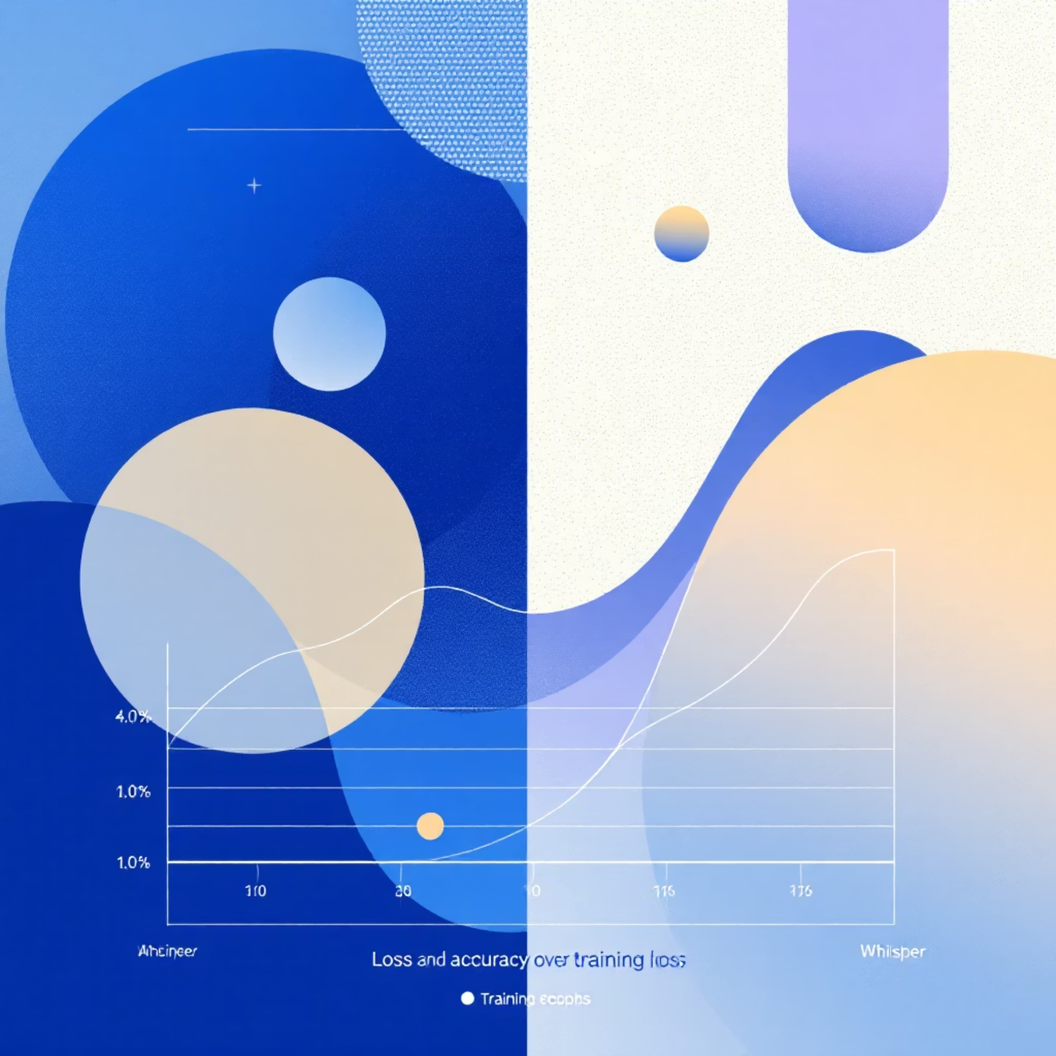
Dataset and Training Pipeline
A meticulously curated dataset and optimized training regimen were key to developing an effective emotion detection model.
Dataset Preparation
Training Configuration
Custom Dataset: Organized into three distinct folders for Happy, Sad, and Neutral emotions.
Epochs: Optimized between 12-25 iterations for convergence.
Splitting: Clearly defined training and validation splits.
Loss Function: CrossEntropy Loss, ideal for multi-class classification.
Preprocessing:
Optimizer: Adam, known for efficient gradient descent.
Resized to 128x128 pixels.
Batch Size: 16, balancing training speed and stability.
Normalized pixel values.
Model Saving: Best model weights saved based on validation accuracy.
Grayscale images converted to 3-channel format.

Slide 7
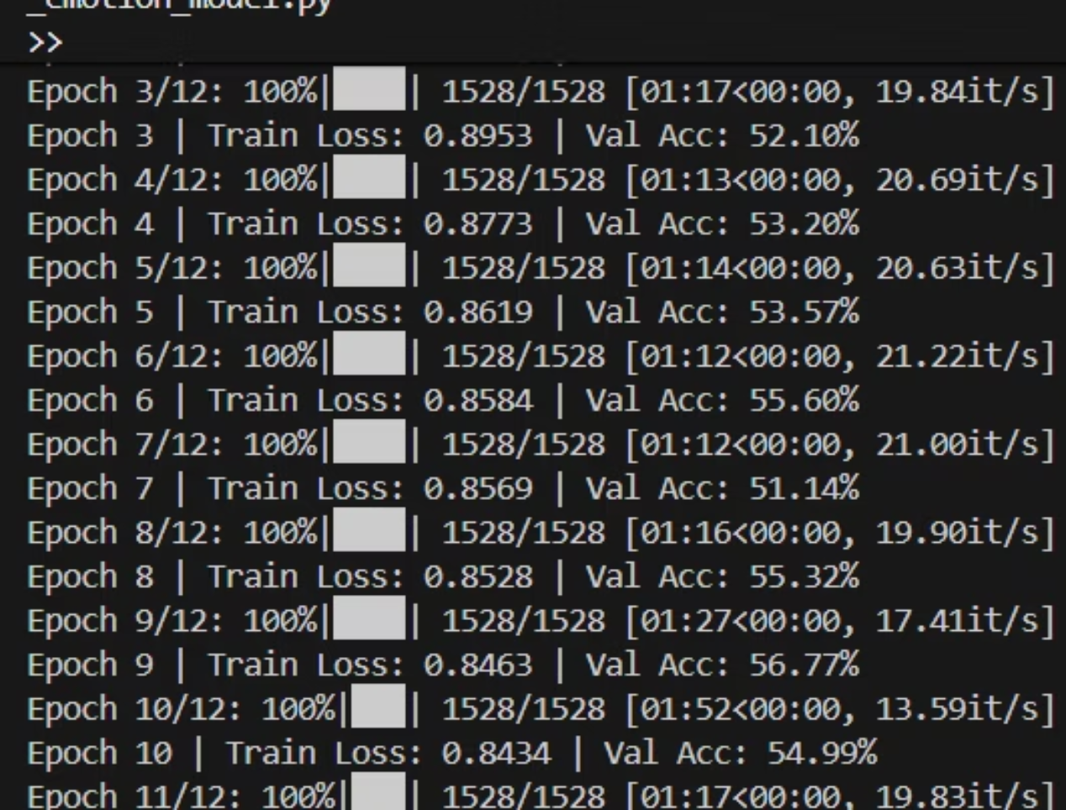
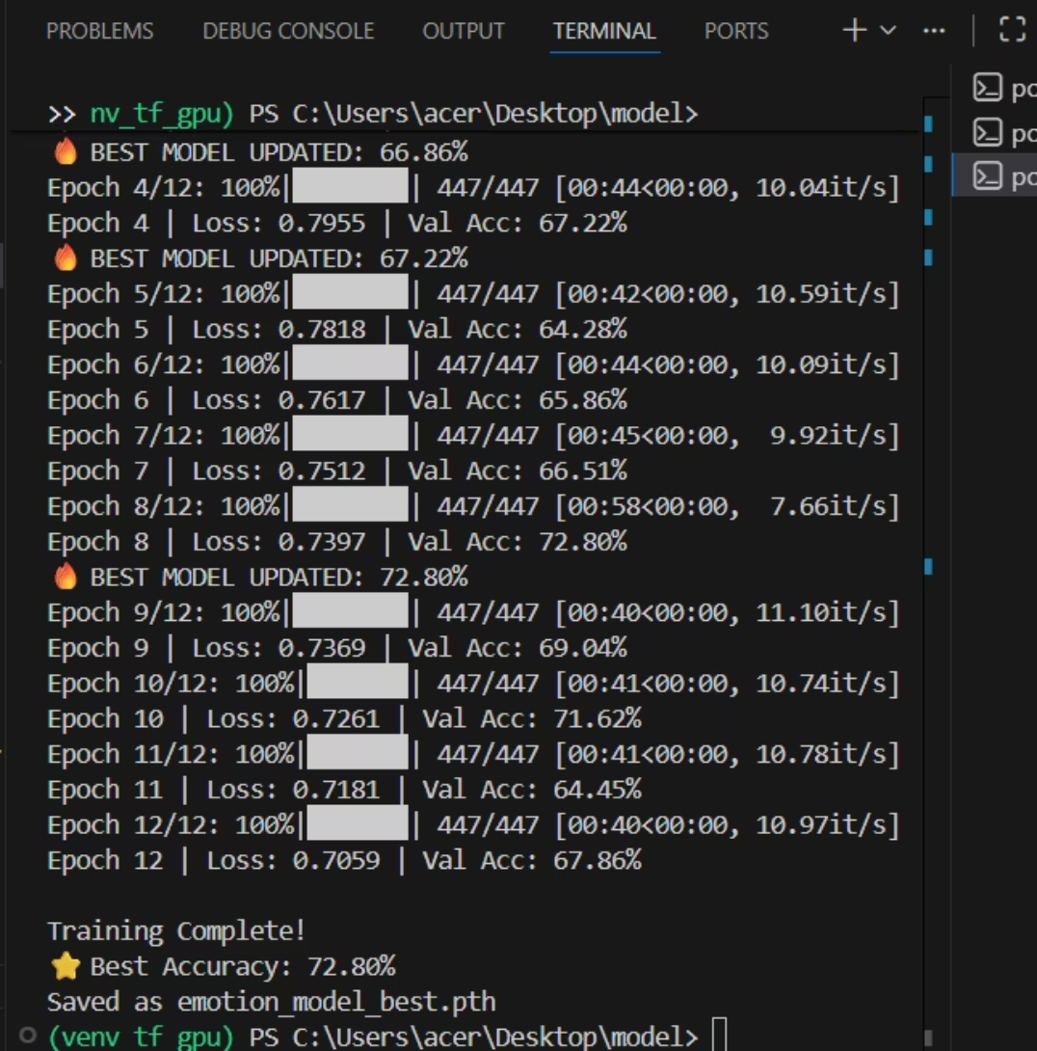
Model Training
Real time training of our model using provided dataset in a set of 12 Epoch .
Maximum Accuracy acquired : - 72.80 %

Slide 8
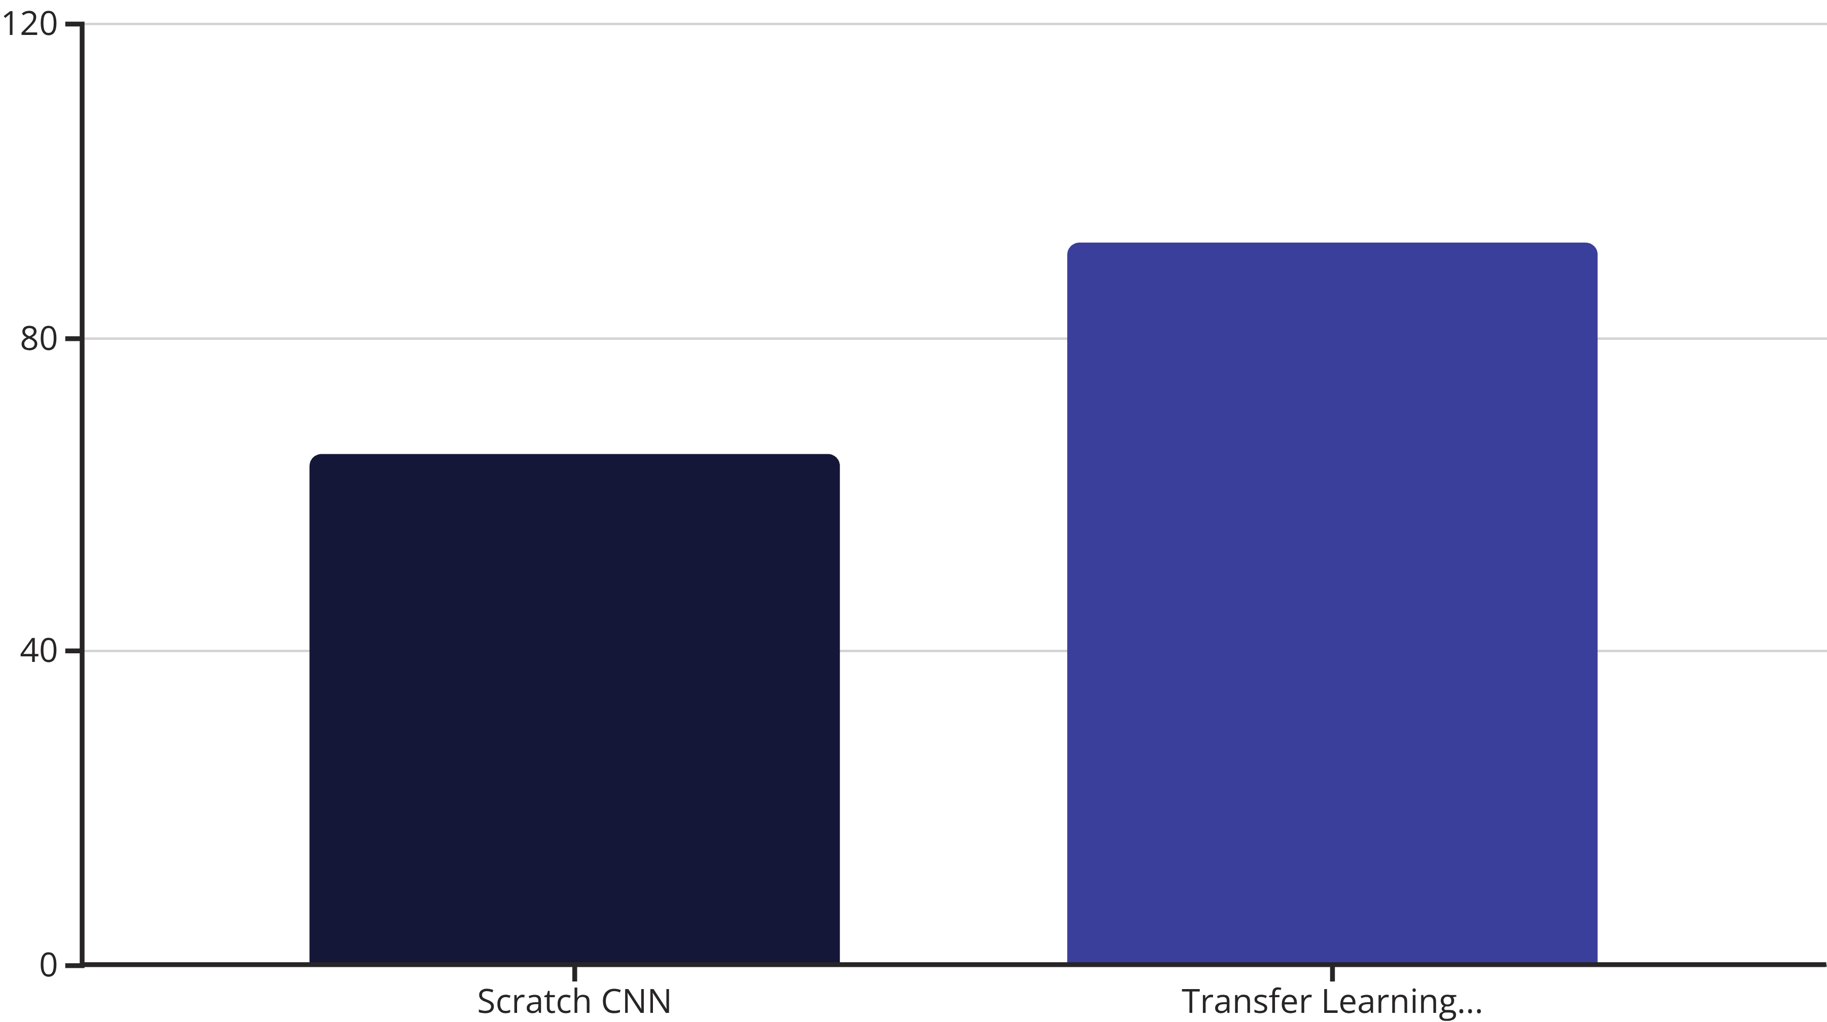
Enhanced Performance and Robust Results
Transfer learning dramatically improved our model's accuracy and real-time reliability.
Accuracy Boost: Validation accuracy saw a significant increase post-transfer learning.
Stable Predictions: Consistent results across varying lighting conditions and angles.
Real-time Efficiency: Inference speed under 30ms per frame for seamless webcam integration.
Reliability: Robust performance even with smaller datasets, proving its adaptability.

Slide 9

Real-Time System & Spotify Integration
Our system integrates seamlessly from webcam input to personalized Spotify playlist playback.
Webcam
Face Detection
Cropped Face
Emotion Prediction
Webcam Input
Face Detection (OpenCV)
Captures live video feed for emotion analysis.
Accurately identifies and crops facial regions.
Emotion Prediction
Spotify Playlist Selection
Our model processes the cropped face to determine the user's emotion.
Dynamically selects a Spotify playlist tailored to the detected mood (e.g., Happy → Energetic, Sad → Lofi).

Slide 10


Conclusion & Future Enhancements
We've successfully developed a robust, real-time emotion-aware music recommender with broad potential.
Key Achievements
Future Scope
Developed a complete emotion-aware music recommendation system.
Expand emotion vocabulary (e.g., Angry, Fear, Surprise).
Achieved reliable real-time performance with high accuracy.
Implement YOLO for even faster and more accurate face detection.
Demonstrated easy integration with existing UI and APIs.
Introduce multi-user support for shared experiences.
Develop a dedicated mobile application for broader accessibility.

Slide 11

Thank You!
Questions & Discussion

